Slide 1
AI, ML & DL

Slide 2

Objectives
In this Lesson, you will learn:
Introduction to Machine Learning
Applications of Machine Learning
Supervised, Unsupervised and Reinforcement Learning
Classification and Regression
Clustering and Anomaly Detection
Recommendation Systems
Algorithms in Machine Learning

Slide 3
AI Landscape
Early 1950 Optimism began
Artificial Intelligence
1980’s Machine Learning begins to flourish
Machine Learning
2010 Deep Learning breakthroughs
Deep Learning

Slide 4
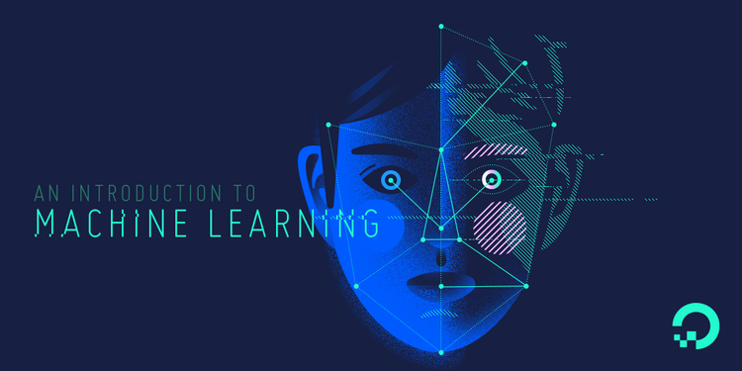

Slide 5

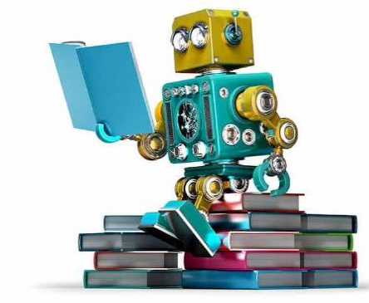
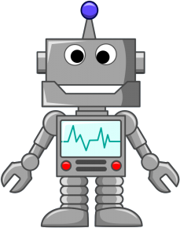
Machine Learning Introduction

Slide 6
Machine learning is a field of computer science that gives computers the ability to learn without being explicitly programmed.
—Arthur Samuel, 1959

Slide 7
Applications of Machine Learning
Financial Predictions, Fraud Detections
Loan Approval
Data Mining – Web Click Data, Medical Records, Diagnosis
Predictive Maintenance
Ad plus user information
Computer Vision – Face Recognition, Self Driving Cars, OCR
Churn Prediction, Customer Segmentation, Sales Forecasting
Voice recognition, Chatbots, Sentiment Analysis, Machine Translation

Slide 8
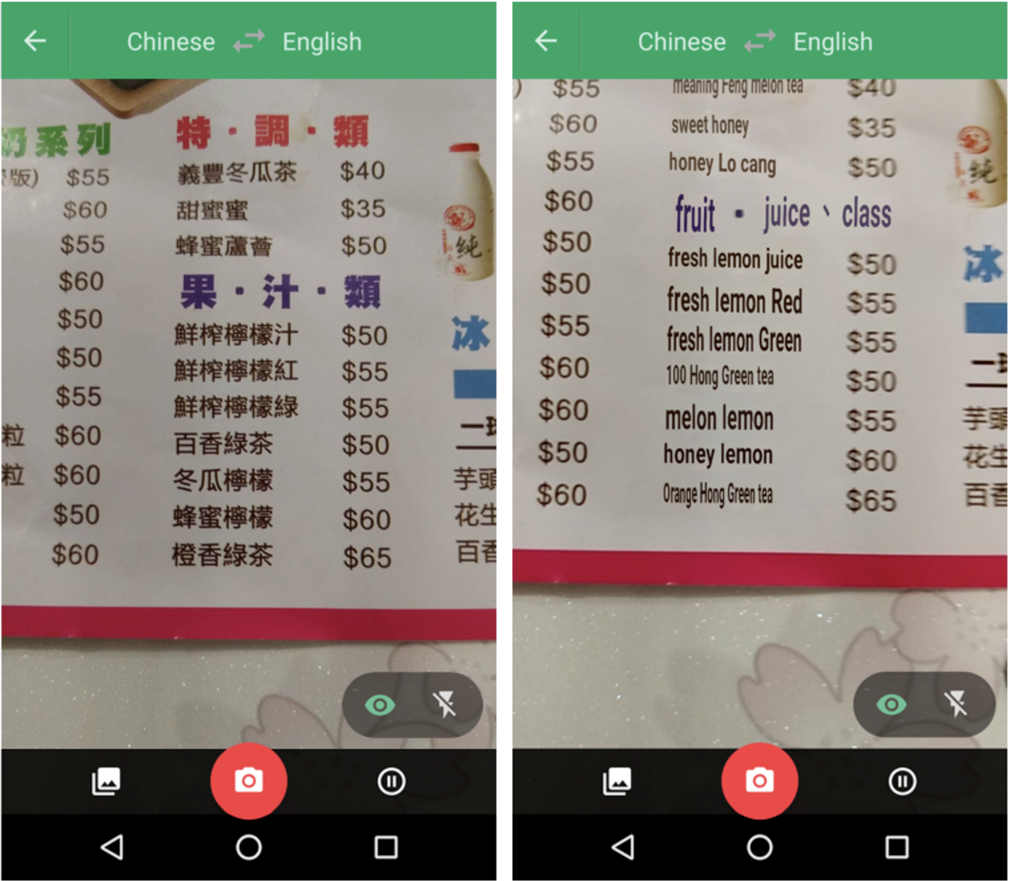
!!
Point your camera at the menu during your next trip to Taiwan and the restaurant’s selections will magically appear in English via the Google Translate app.
Google Translate overlaying English translations on a drink menu in real time using convolutional neural networks.

Slide 9
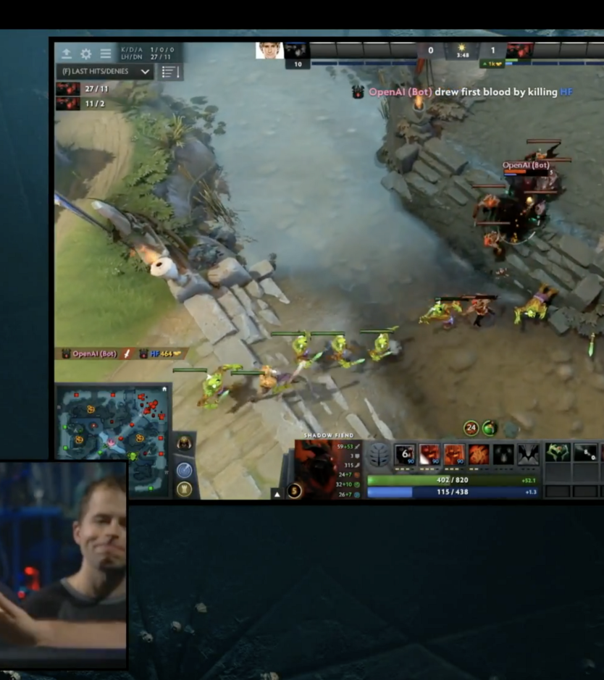
!!
Just a few months on August 11, 2017, OpenAI
reached yet another incredible milestone by
defeating the world’s top professionals
in 1v1 matches of the online multiplayer game Dota 2.

Slide 10

!!
How machine learning is helping Virgin boost its frequent flyer business
Virgin Australia is looking to build models that can predict the types of people that are more likely to travel, the types of travel people are likely to undertake, the prices that travellers are willing to pay, the importance of accommodation relative to travel, and the importance of experience compared to travel.

Slide 11
Applications of Machine Learning
Manufacturing | Retail | Financial Services
Predictive maintenance or condition monitoring Warranty reserve estimation Propensity to buy Demand forecasting Process optimization Telematics | Predictive inventory planning Recommendation engines Upsell and cross-channel marketing Market segmentation and targeting Customer ROI and lifetime value | Risk Analytics and Regulations Customer Segmentation Cross-selling and up-selling Sales and marketing campaign management Credit worthiness evaluation
Travel and Hospitability | Health Care and Life Sciences | Energy, Feedstock and Utility
Aircraft scheduling Dynamic pricing Social media — consumer feedback and interaction analysis Customer complaint resolution Traffic patterns and congestion management | Alerts and diagnostics from real-time patient data Disease identification and risk stratification Patient triage optimization Proactive health management Healthcare provider sentiment analysis | Power usage analytics Seismic data processing Carbon emissions and trading Customer-specific pricing Smart grid management Energy demand and supply optimization

Slide 12
Objective of a ML Algorithm
Getting better at a task through practice
The act of remembering: data / experience
Generalisation, similarity and new inputs
Learning and flexibility: adaptation

Slide 13
Programming Languages -
Python | R

